Slide 1
Cloud services: Monitoring, data, and analytics
INF-2202
Tor Kreutzer & Jan-Ove Karlberg tokreutz/jakarl@microsoft.com

Slide 2
Outline
Why cloud?
Cloud differences and architecture
Monitoring and operating cloud services
Why Azure Data Lake?
Analytics and aggregation in ADL

Slide 3
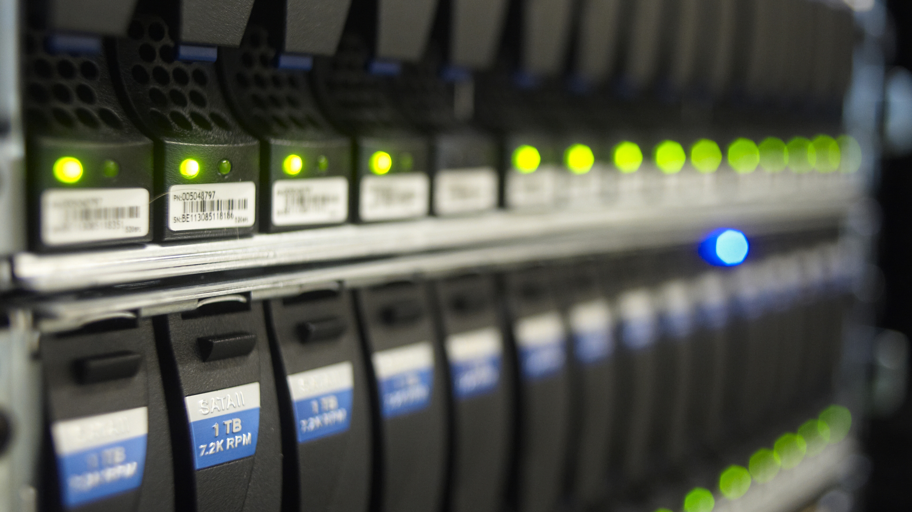
Why Cloud?
Hardware as a service
Buy VMs by specification
Never mind actual machines
Software as a service
If you want a database, don’t buy disks
Notes:
Cloud is a bit of a buzzword, but also one of Microsoft’s most important businesses. It allows us to abstract away hardware, and instead focus on virtual machines. Also, can use software as a service to avoid thinking along the lines of hardware all together. Mail (gmail or outlook), file storage (icloud), SharePoint (intranet) etc. If you want a database, there is no need to buy disks. Instead you can buy the database as a service, and just specify the amount of storage you need, as well as the expected read & write throughput.
This also goes for internal services; In our day to day job we rely on “key value store as a service”.

Slide 4
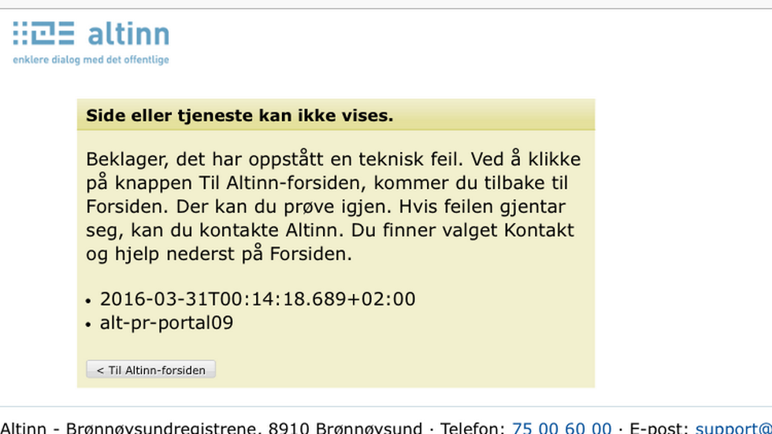
Why Cloud?
Pros
No up front hardware cost
Elastic scale
Hardware scales with usage
Only pay for what you need
Less hardware management
Let someone else swap dead disks
Provisioning machines not done over night
Notes:
Buying machines is very expensive – especially good servers. Buying servers in order to support that annual flash crowd might not be good investment. Instead, cloud provider can do this for you. You get performance when you need it, and don’t pay for electricity and hardware when it is not used. Also, consider how long it will take to get the machines you need (becomes a significant part of long term planning).
Whether or not hardware is available can be the differentiating factor on deadlines.

Slide 5

Why Cloud?
Cons
Hardware resources shared across services
And sometimes also customers
More software management
“Hardware” looks like software
Needs to be configured
Trust?
Notes:
Can be difficult to ascertain why performance looks the way it does. If you absolutely need to make sure that you run in isolation (e.g. because of sensitive data and paranoia), that will cost you extra. Nothing is totally free, you have to pay some configuration/management cost (for VMs).
Do you really trust your cloud provider? Not only wrt. Privacy, but also for keeping your data safe if disaster strikes.

Slide 6
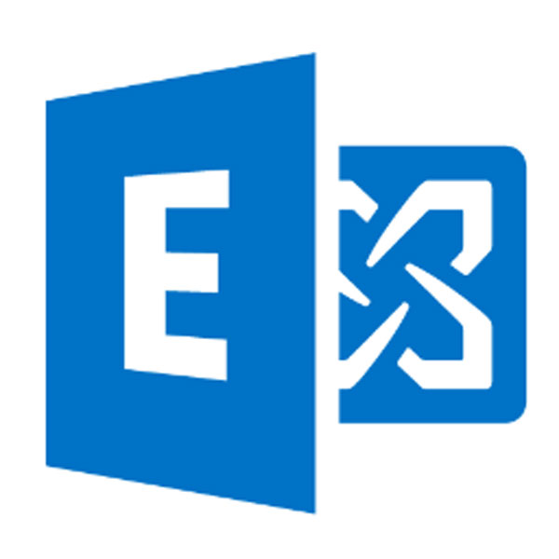

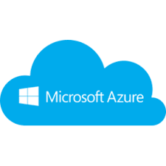
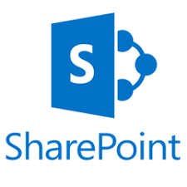
Cloud use in Microsoft
Multiple cloud systems
Internal Clouds:
Exchange, Bing, Azure, SharePoint, Cosmos (DataLake predecessor), ++
Public Cloud Platform:
Azure
Notes:
It is somewhat interesting that in Microsoft we operate with multiple internal clouds. These are all suited for specific needs and generally provide software as a service. Azure is the only real cloud platform – a place where you can buy and provision both software as a service, e.g caching, databases, analytics, as well as virtual machines with desired configurations. We have an “internal azure” that differ slightly in what is currently available, typically pending certifications etc. We also have different Azure environments for differently certified services.

Slide 7
Enterprise vs. Consumer market
Different requirements
Consumer historically less strict
Security
How do we keep data safe?
Privacy
How do we keep e.g. access logs “anonymous”?
Geo-restrictions
How do we make sure data stays where it should?
Notes:
The consumer side of things have typically been less strict. This has changed rather drastically in later years (Snowden?). Trust and certifications are some of the major selling points of Microsoft when compared to the competition. It is very difficult to retro-fit mechanisms and technology for ensuring security, privacy, and compliance in general. This is one of the reasons Google still has not taken over the business market. At this time is might be good to define what we mean by these terms; Security is related to related to how data is accessed (authorization, authentication) and stored (encryption). With privacy we want to make sure no sensitive data leaks, for example via logs, exceptions, and so on. An access log should support auditing but I should never be able to see which user did something. Compliance is about meeting all such requirements.

Slide 8
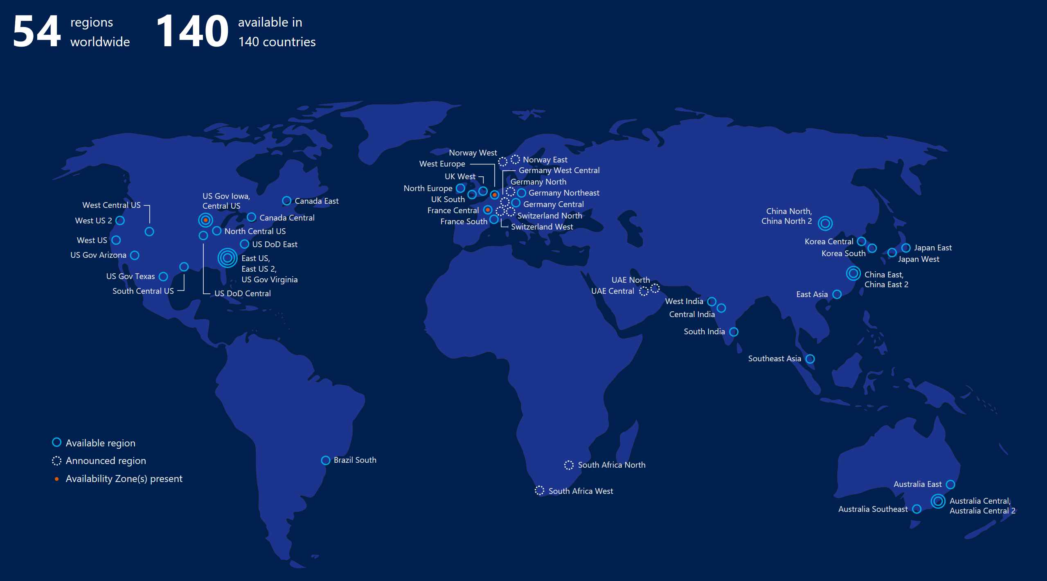
Cloud service architectures
All large services are distributed
Storage and compute replicated
Provides availability and reduces latency
Sometimes at the cost of consistency
But lets not go down that rabbit hole!
Notes:
Brief summary of what being/using a cloud service implies: For availability and latency, we often replicate resources both within data centers, across data centers, and across regions. Sometimes, these things are more important than consistency.

Slide 9

Cloud service architectures
This gives us some challenges
Different time zones
Different regions (locales)
Different software versions
Rollouts could take months!
Latency
Services no longer run on premise
Notes:
If we want completeness of logs, we need for all data from a single day

Slide 10

Monitoring and running Cloud Services

Slide 11
How do we monitor service health?
Telemetry
te·lem·e·try, noun the process of recording and transmitting the readings of an instrument.
Metrics
Logs
Notes:
In order to monitor our services we need to gather telemetry. In short, telemetry covers both metrics – e.g. latency numbers, event counts, etc., and logs. Logs are more verbose things, comparable to all the printf debugging everyone does.

Slide 12
How do we monitor service health?
Trends
Based on logs and metrics
Aggregates (averages, sums, counts, etc.)
Can involve more expensive computations
Notes:
If we dive a little deeper into what kind of questions we want to answer, we can either use the raw telemetry or work on some derivative. For example, if we want to do trend analysis we might want to do computation over some historical data. In order to conserve space or have some more easily accessible data in a more convenient format, we might do aggregates. The take home point is that the raw telemetry might exist in a format or a system that is not directly suitable to answer the questions we might have. In our case, one of the clearest such cases is that of trends.

Slide 13
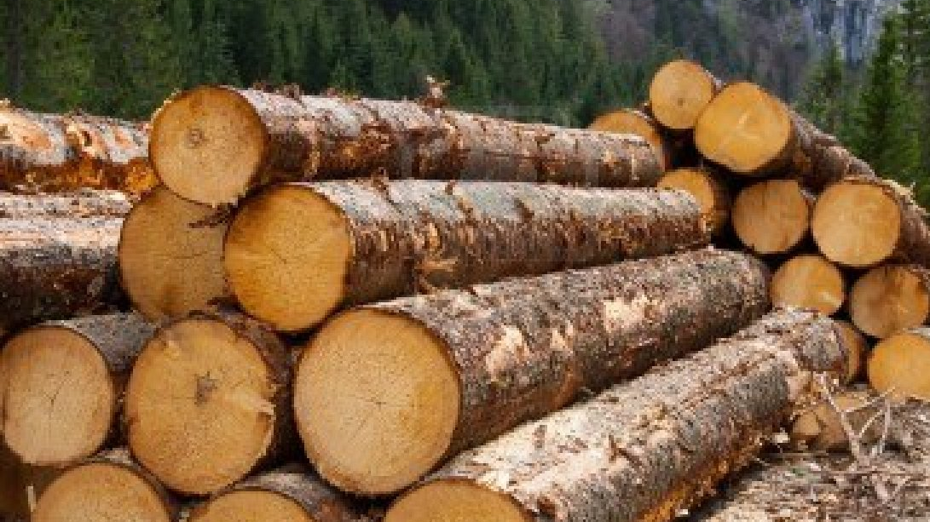
How do we monitor service health?
Logs
For investigations and debugging
E.g exceptions and stack traces
Profiling
Where is time spent?
Functional validation
Are results as expected?
Auditing
Who has accessed what?
Notes:
The most verbose and thus space intensive. This is the go-to source of information if one needs to do investigations or debugging. Although most logging is voluntary, some is actually necessary to meet compliance standards. For instance, there needs to be proper logging in place to support auditing. For example, who has accessed this data? Also notice that we need to support auditing of things we as operators have done. For example, if we have accessed logs on a server in order to do some debugging, there needs to be a paper trail indicating that this happened under correct circumstances.

Slide 14

How do we monitor service health?
All of this is more complicated than it sounds
Geo-restrictions
What is stored in Germany stays in Germany
Privacy
No human readable metadata (paths, urls, addresses, usernames,…)
Different classes of data
Security
No data in plain text
No un-authenticated access
Notes:
Now that we have outlined how it is possible to monitor a cloud service it is important to remember that nothing is as simple as it sounds. Again, much of the pain comes from compliance, but there are also other issues to take into account. For instance, how do you correlate and gather performance data for a distributed system? Web client calls front end server, front end server calls back end server, back end server needs to read from database, etc.

Slide 15

Economy of scale
Log quality
Every byte counts at this scale
All cycles matter
Think before you log!
Notes:
When doing logging in large cloud systems volume often grows extremely rapidly. Petabytes of logs is common, we run jobs of that magnitude every night. If you can save a few bytes, that quickly amounts to a disk. If you can save some cycles or reduce memory consumption, that turns into cash real quick.
At one of our hackathons, a guy fixed a single “million dollar bug”.

Slide 16
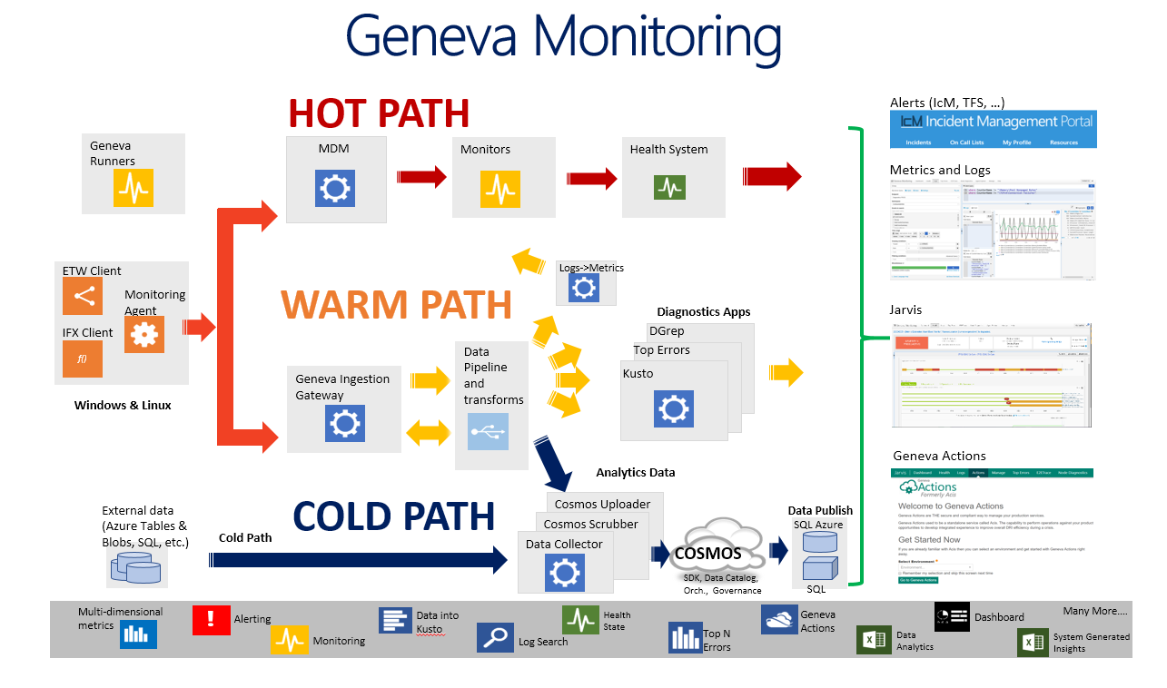
Hot path, Warm path, Cold path
Notes:
In order to be able to meet all of our requirements, we need different systems. Real time alerting is not done the same way as peta-scale data analysis. We will now walk through how we use three classes of systems to handle data in different ways.

Slide 17
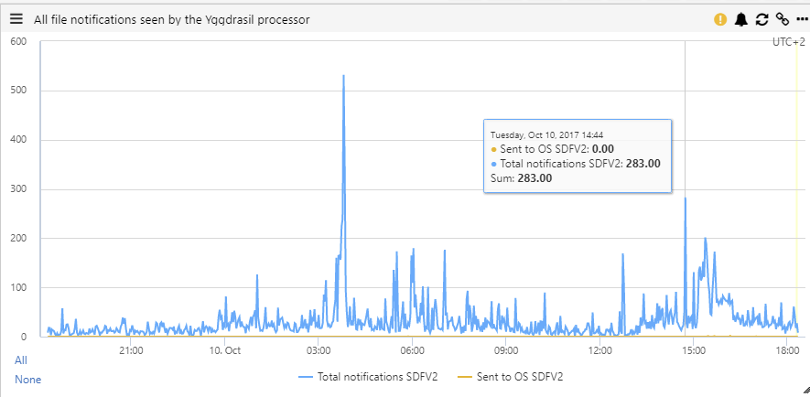
Hot path, Warm path, Cold path
Hot path – real time monitoring (< 1 min)
Event counts
Latencies
Alerting
Notes:
Sub minute, only metrics such as latencies and event counts, number of successes/failures etc. Suitable for building dashboards for monitoring a live service.

Slide 18
Hot path, Warm path, Cold path
Warm path – close to real time logging (< 5min)
Text based logs
Debug messages
Exceptions
Performance numbers
Short retention (< 2 weeks)
Notes:
Excellent for doing “live debugging”, monitoring rollout of new versions or features. Often supports query capabilities. Expensive indexes mean that we cant keep this around forever!

Slide 19
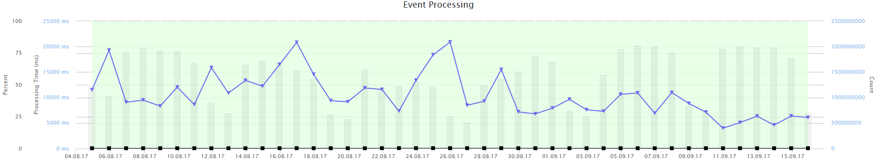
Hot path, Warm path, Cold path
Cold path – Historical completeness
Text based logs
Metrics and counters
Long retention
Delayed data entry
Notes:
Often used for capturing trends over long time spans. Often have good compute capabilities: possible to create expensive aggregates or summaries over data. For completeness, we need to lag behind. We usually lag 2 days to account for time zones and machines going up and down. We will talk more about how this can be achieved in the next lecture.

Slide 20
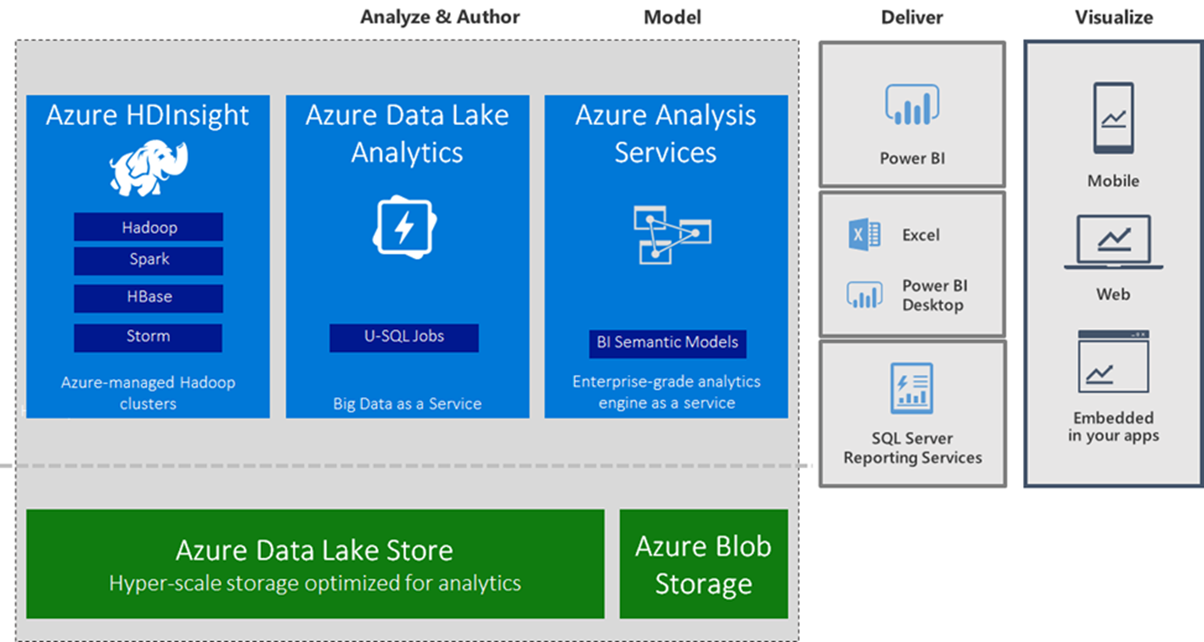
Azure Data Lake Overview
Why Azure Data Lake (ADL)
Where ALD comes from
What ADL provides
U-SQL examples
Notes:
This is like an “agenda” slide…

Slide 21
Azure Data Lake Origin
Cosmos / Scope
Azure Data Lake / U-SQL
Cosmos
Single Microsoft internal service
Dedicated datacenters
Azure Data Lake
Azure service offering
Azure datacenters
Notes:
Current solution runs on mostly open source software, combining these to give a rich environment.

Slide 22

Azure Date Lake Motivation
Enormous amounts of data
Many data sources
Thousands of services
Hundreds of thousands of machines
Heterogeneous
Spread across many different solutions

Slide 23
Data Lake Provides
Uniform solution
Gives greater flexibility to correlate between systems
Ability to centralize solutions
Fewer moving parts
Notes:
Developers from all teams share the same tools
Fewer custom solutions
Fewer projects pulling in different directions
Ability to use the same toolchain for data originating from different systems
Public offering -> more users provide input

Slide 24
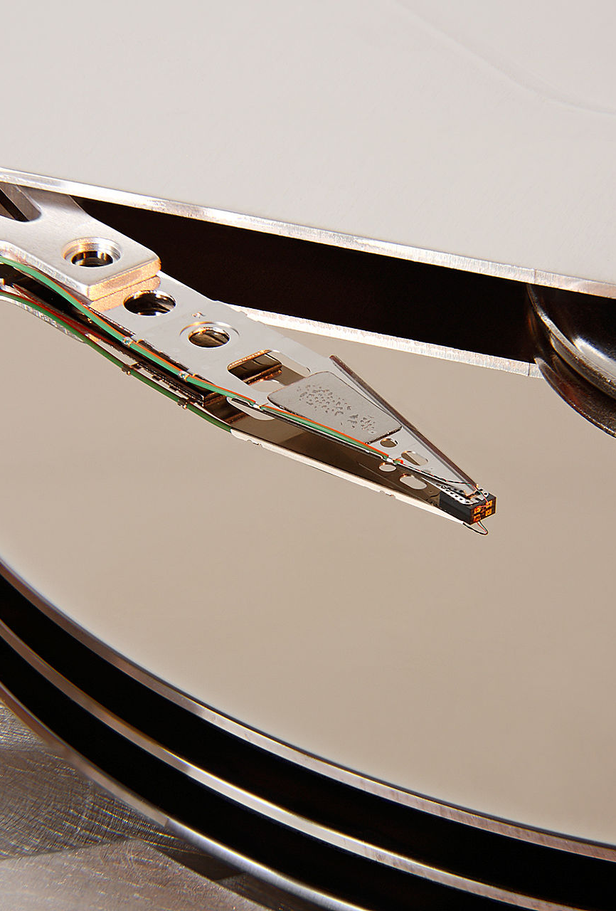
Data Lake Provides
Large storage capacity
Cloud-Scale File-System
Redundancy for availability and performance
Large compute capacity
Batch
Interactive
Machine Learning
Notes:
Work on streams, can think of these as petabyte sized files.
Computation done close to data -> performance and redundancy when machines die.

Slide 25
Cosmos Capacity & Usage Trends
Date | Machines | Tokens
2014/12 | 172K | 828K
2014/10 | 142K | 798K
2014/07 | 122K | 550K
Petabytes Stored

Slide 26
Data Lake Provides
@data1 =
EXTRACT
Date string,
Region string,
TenantName string,
FileName string,
ModifyingUsers string,
FirstAccess string,
LastAccess string
FROM @«input.tsv"
USING Extractors.Tsv();
@outrows = SELECT *
FROM @data1
WHERE Region.StartsWith("EUR");
OUTPUT @outrows
TO @"/my/output.tsv"
USING Outputters.Tsv();
Powerful query language
Inspired by SQL
Closely integrated with C# .Net
Embed C# code in U-SQL and use libraries in .NET Assemblies

Slide 27
Questions?

Slide 28
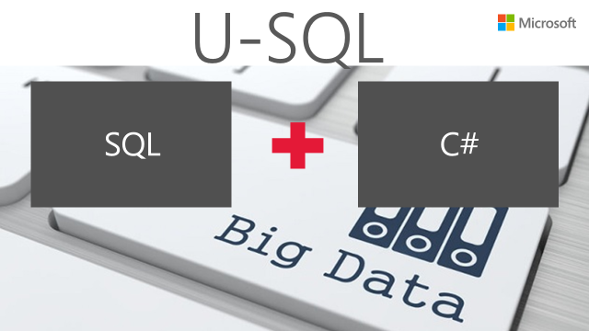
Now for some examples!
How to read a file and select rows based on criteria
Some simple aggregation
Joining logs with correlations

